Slide 1

Capstone Project – Milestone Report #1
Alexsandra Guerra
2/10/2017
Spring Board Data Science Intensive

Slide 2

Introduction
Client
Problem & Needs
The client is Southern California Edison (SCE). SCE’s mission is to provide clean, reliable, and safe power to its residents. In order to meet the clean energy demands of its customers, SCE has many teams and projects aimed to meet the demands for increased solar PV systems by its customers. It is also conducting studies to better understand the adoption of solar PV systems by commercial customers.
SCE research and development engineers will use this analysis on a quarterly basis to keep track of the increase of solar on the grid, and to compare and track performances against other CA IOUs. This analysis will help SCE engineers identify potential partners for demonstration projects.
Objective:
Create script to clean data, analyze and output visualizations to SharePoint Site.

Slide 3

The data used is public record of solar PV installation applications
The data is from California Solar Initiative (click here to access) and is a record of anyone trying to connect their Net-energy-metering (NEM) solar PV system to the grid. The data includes over 111 columns, each row representing one application. The columns of interest in this analysis are listed to the right.
California Distributed Generation Statistics publishes all IOU solar PV net energy metering (NEM) interconnection data from the three large California Investor Owned Utilities (IOUs) which include Pacific Gas & Electric Company (PG&E), Southern California Edison Company (SCE), and San Diego Gas & Electric Company (SDG&E) per CPUC Decision (D.)14-11-001.
Data fields of interest:
Utility (SCE, PGE, SDGE)
Application Status
Installer (like SolarCity)
Application Completed Date
Service ZIP

Slide 4
Data was cleaned & filtered for relevant information
1_clean_and_filter.ipynb
Run to load and clean data. Outputs an excel file to then load into step 2
2_run_analysis.ipynb
This is step 2 that plots and looks at the data and outputs to HTML template for SharePoint Site (using beautilfulSoup)
Only applications with status of “installed” were included
Needed to reformat string values to be consistent (all uppercase)
Duplicate rows were dropped and recorded for results table
Removed the bottom & top 0.5% of data on System Size DC (erroneous)
Any applications with ‘System Size DC’ as null
Limitations of Data:
The data set is limited to the record keeping of the individual utilities that provide the data to CSI. For example, only data that was required after a date was included, so the complete history and total installations is not represented.
Scripts:

Slide 5
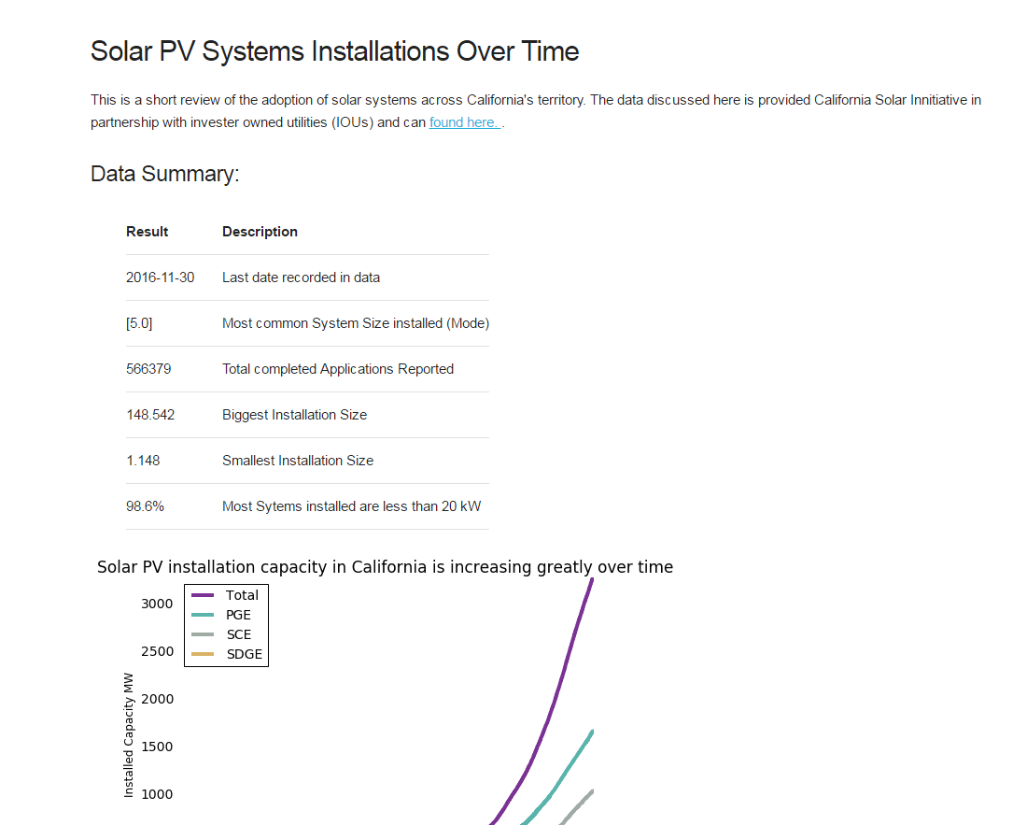
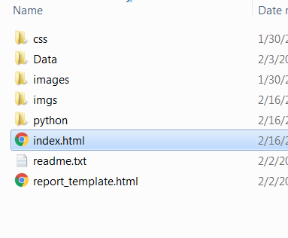
Results are output to HTML template
Files & Folders:
Web page with plots and statistics tables

Slide 6
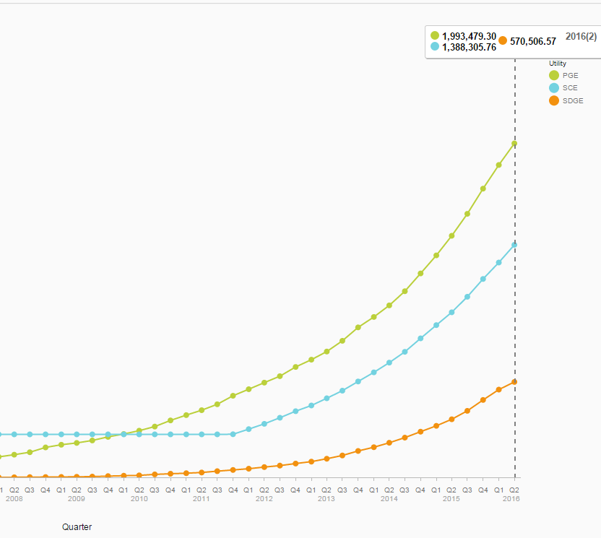
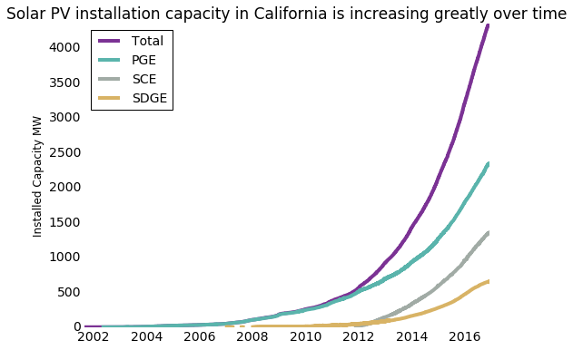
Data Validation: compare to SAP Lumira visualization tool
Python – cumsum()
SAP Lumira
Comaprison to validate that the script & results are making sense
- The results match well

Slide 7
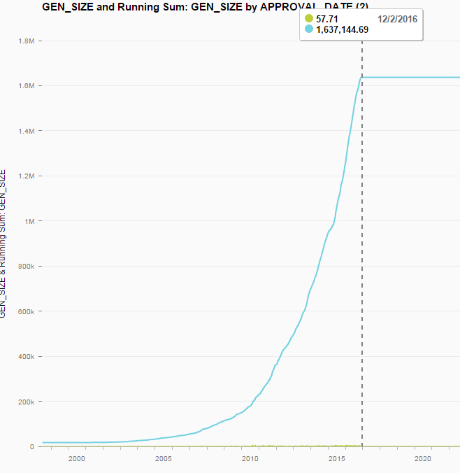
Data Validation: Compare to internal SCE data set
Python – cumsum()
SCE Total Installed: 1.35 GW
SAP Lumira:
SCE Total installed: 1.6 GW
Filtered for system sizes 1 to 1000 kW

Slide 8
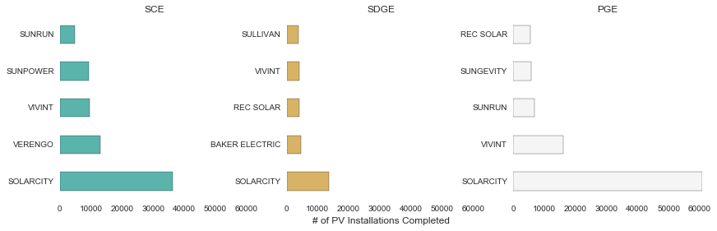
Example Plot: Top 5 installers in each IOU territory

Slide 9
Next steps
Pull in other data sets to validate
Discover why SCE dataset is different than CSI data set (total installed is .3 GW off)
Create Bokeh interactive plots for SharePoint Site
Test publishing to SharePoint Site

